Slide 1
F# MVC for WPF
Dmitry Morozov
April 23, 2013

Slide 2
Deliverables
Library: http://github.com/dmitry-a-morozov/fsharp-wpf-mvc-series
Learning series: http://github.com/dmitry-a-morozov/fsharp-wpf-mvc-series/wiki
And today’s presentation ☺

Slide 3
GOALS
Deliver something useful for F# community (share experience)
Support “F# is general purpose language” movement
Series that back ups demo is great language tutorial

Slide 4
GUI APPLICATION DEVELOPMENT
Inherently hard
Essential complexity
OOP was thought as THE way to handle it

Slide 5
Mvvm introduction
Variation of Martin Fowler’s “Presentation Model” pattern
Certainly better than old fashion “Autonomous View” (Code-behind)
De-facto standard for XAML-based frameworks
WPF, Silverlight, Windows Store Apps (even WinForms)
For details see Chris Marinos’s “Getting Your Func(tional) on with F#” http://www.meetup.com/nyc-fsharp/events/22059701/
Daniel Mohl’s F# Project Templates:
F# and C# Win App (WPF, MVVM)
F# Windows App (WPF, MVVM)
Gustavo Guerra’s WPF helpers http://github.com/ovatsus/FsWpf

Slide 6
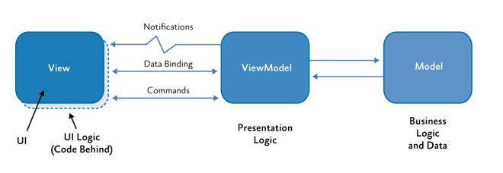
MVvm (Model-View-ViewModel)

Slide 7
Mvvm shortcomings
ViewModel = Controller (imperative) + Model (declarative)
Hard to manage complexity once it grows (SRP ???)
No support for presentation logic composition
A lot of boilerplate code
INotifyPropertyChanged
Event subscriptions, Command bindings
Typeless Model-View bindings (magic strings/reflection)
No support from type system/compiler
No support from IDE (refactoring/navigation)
Inconsistent event processing
Commands, event handlers, blend behaviors, etc.

Slide 8
Can we do better in F#?
Classic MVVM designed with C# limitations in mind

Slide 9
FIRST class EventS-Driven architecture
type View = IEvent<Events>
and Events =
| Add of int
| Subtract of int
type Model = { State : int }
type Controller = Events -> Model -> Model
type Mvc = Controller -> Model -> IEvent<Events> -> Model

Slide 10
model
Not domain model
Based on Castle Dynamic Proxy
Raises INPC.PropertyChanged from setter interceptor
Implementation: base class + factory method
Support for abstract properties makes coding in F# easier
DECLARATIVE (type definition only, no imperative logic)

Slide 11
VIEW
type IView<'Events> =
inherit IObservable<'Events>
abstract SetBindings : obj -> unit
Event source
Data binding target (model is the DataContext)
F# support for .NET events makes experience really smooth
Capture state (callback) along with event

Slide 12
Model – subset of view state
View
Model
Data binding

Slide 13
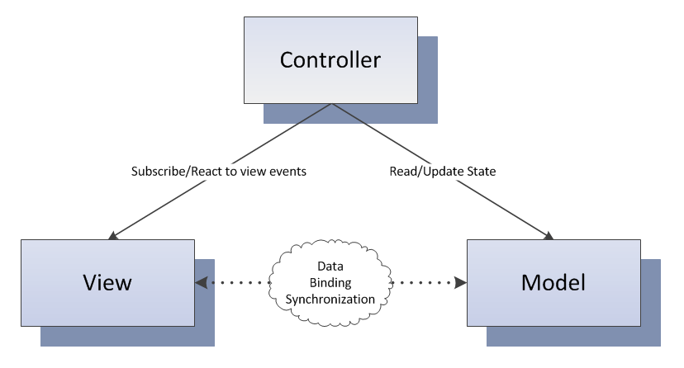
Controller
YOUR PRESENTATION LOGIC HERE

Slide 14
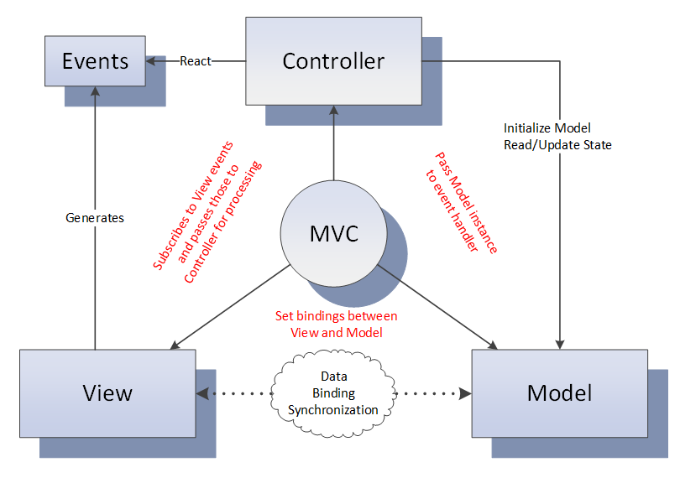
MVC – gluing pieces together
Depends only on ‘Events and ‘Model –
TESTABILITY

Slide 15
Data binding
type IView<'Events, 'Model> =
inherit IObservable<'Events>
abstract SetBindings : 'Model -> unit
<@ control.Property <- model.Property @>
Making implicit dependency explicit
Leveraging F#/.NET type system
Leveraging IDE/compiler
Doing something slightly better than “by convention”
Optional module

Slide 16
Validation
Optional module
Would be verbose without F# language features:
Active patterns
Explicit member constraints
Partial application

Slide 17
Async
type IController<'Event, 'Model> =
abstract InitModel : 'Model -> unit
abstract EventHandler : ('Event -> 'Model -> unit)
type EventHandler<'Model> =
| Sync of ('Model -> unit)
| Async of ('Model -> Async<unit>)
type IController<'Events, 'Model> =
abstract InitModel : 'Model -> unit
abstract Dispatcher : ('Events -> EventHandler<'Model>)
“Async in C# and F#: Asynchronous gotchas in C#” blog post by Tomas Petricek

Slide 18
Child Windows
Dialog – synchronous computation
Non-modal window - asynchronous

Slide 19
Reentrancy
Very tricky problem

Slide 20
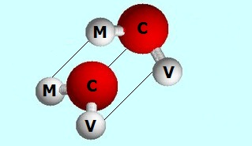
composition

Slide 21
External event sources
As easy as composing views
Rx.NET helps to ensure invocation on GUI thread
Another composition option

Slide 22
Data binding micro dsl
Scrap your boilerplate
F# gives great tools to build internal DSLs

Slide 23
Derived properties
Scrap your boilerplate
F# pure magic
ReflectedDefinitionAttribute
Quotation
Active patterns (a lot)
WPF black magic
Custom dynamic dependency properties
MultiBinding

Slide 24
F# 3.0/.net4.5
Queries
Type providers
WSDL
XAML
INotifyDataErrorInfo
ExceptionDispatchInfo

Slide 25
F# MVC for WPF
No INPC boilerplate model
Abstract polymorphic view
Loosely couple controller
Type checked event to handler mapping
Statically typed data-binding DSL
Lightweight validation
Type system supported Async
Dialogs/Windows as sync/async workflows
Reentrancy problem solved at one place
COMPOSITION
External event source
Declarative derived properties
Queries, type providers …

Slide 26
In summary
F# great general purpose language
Hard things easy impossible things possible

